Slide 1


IMS Project
2021
Lukasz Dudek

Slide 2
Consultant Journey
Agile – Scrum, Kanban (Jira)
Source Control – Git, GitHub
Cloud – GCP
Database – MySQL
Programming Language – Java
Build Tool – Maven
Testing – Junit, Mockito

Slide 3
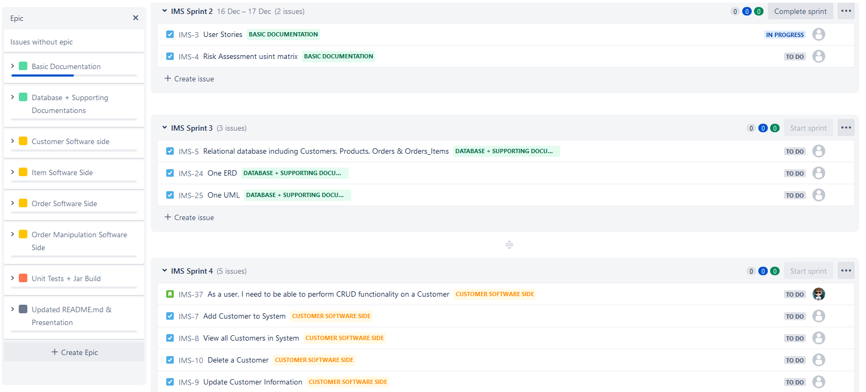
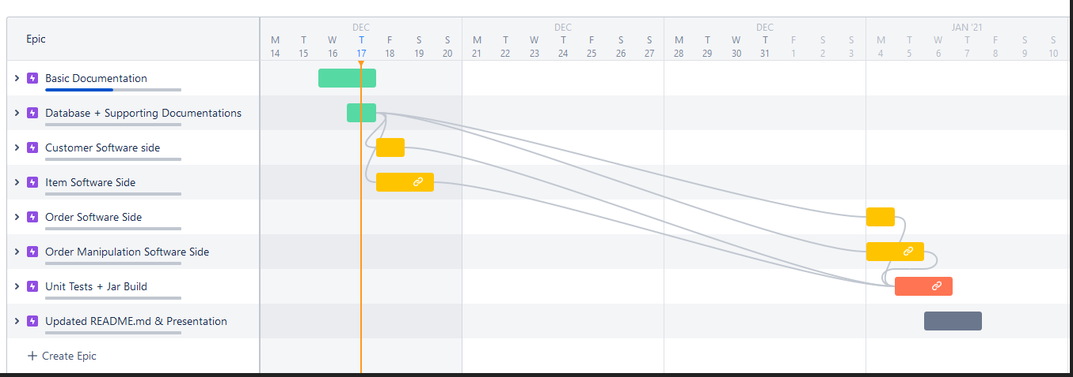
Kanban Board (Jira)
Used Jira to manage Project timeline
Split up work into small tasks

Slide 4
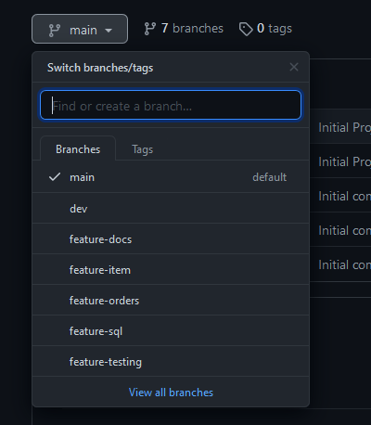
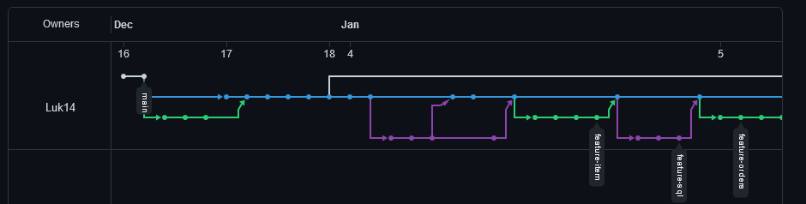
Source Control
Used a Feature Branch Approach
Kept comments clean and linked to Jira

Slide 5
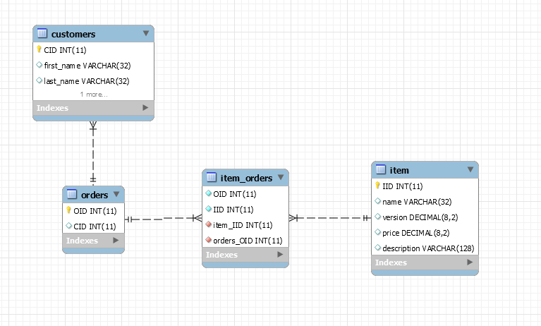
Database
We have used MySQL for this Project
With 3 tables and 1 joining table

Slide 6
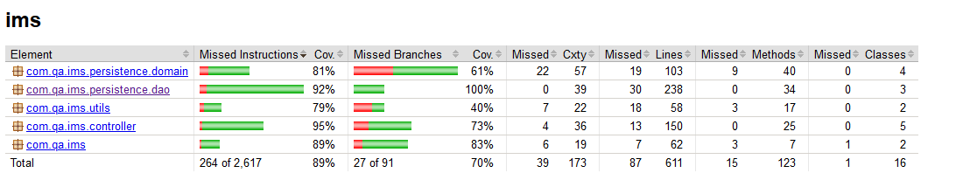
Testing
Used Junit and Mockito for testing the Project
Objective was to meet an industry standard of 80%+

Slide 7
Demo Time!

Slide 8
Sprint Review
What went well?
  Testing was above the Standard
  Full MvP was met
What did not go well?
  Time estimations on Jira, some took longer then anticipated
  One known issue in the current program

Slide 9
Sprint Retrospective
How could I improve next time!
  Estimations should have been further evaluated, before putting down a time
  Jira and GitHub integration should have been used more often

Slide 10
Any Questions?

